Slide 1
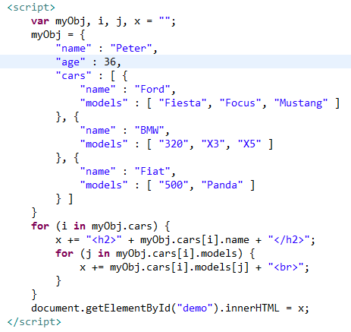
Nested Arrays in JSON Objects
Values in an array can also be another array, or even another JSON object

